Slide 1

HubSpot Sales Tool Insights
Nishant Mohan

Slide 2
Contents
Assumptions
Exploratory Analysis
Customer Segments
Insights
What next?

Slide 3
Assumptions
The given data is from 2019, week 38 through 42
When the user signs up for sales tool, the flow is
Stream can be viewed at anytime
Notifications are received for emails read and replies
Add Gmail extension
Import Gmail contacts
View Contact insights
Create tracked emails
Wait for notifications
View insights

Slide 4
Exploratory Analysis

Slide 5
Higher sign-ups towards beginning of the week
Higher Sign-ups also mean higher churn
Need to compare with non-churners to validate

Slide 6
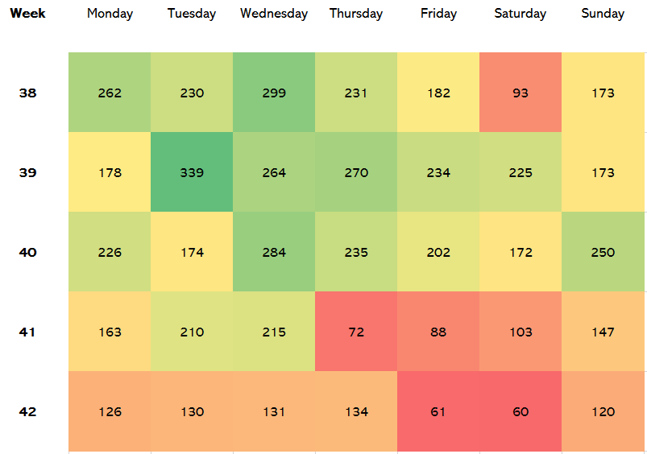
Lesser churners every week
Again, lower churners mean lower sign-up rate
Within week trend follows
Was there a marketing campaign before week 38?

Slide 7
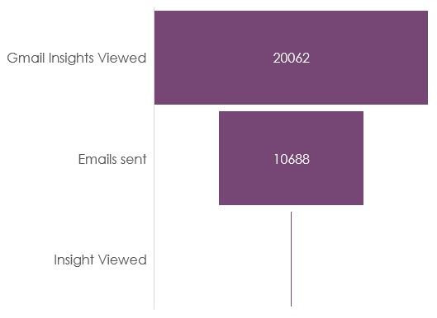
User Funnel
Highest fall occurs after the users send the emails
More metrics needed to get a clearer picture
Assumption: Stream views can occur at anytime during the flow

Slide 8
73% Users sent only 1 Email
Possible that the 1st mail sent in the guided tour in the tool is the only mail sent
Suggestion: A notification to users to send an email by themselves!?

Slide 9
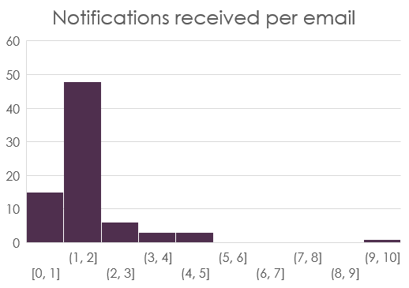
Most of the churners did not receive much response
Users leave because they did not get good response
Assumption: Response is linked to number of notifications received
Suggestion: Show improved insights in contacts for better targeted trackers?

Slide 10
Customer Segments

Slide 11
Segmenting customers
Elbow-method suggests 3 clusters
This gives a balance of high homogeneity and small number of clusters

Slide 12




Clusters At A Glance
Cluster | 0 | 1 | 2
No. of Users | 6272 | 181 | 3
Mean Trackers created | 1.51 | 6.67 | 2.67
Mean Notifications sent | 2.02 | 15.2 | 14.33
Mean Gmail Insights Viewed | 1.94 | 38.02 | 327.33
Mean Insights Viewed | 0.01 | 0.03 | 0
Mean Stream Viewed | 3.21 | 4.02 | 2.33
Mean Notification per email | 1.47 | 2.17 | 4.75

Slide 13
Insights

Slide 14
Understanding the Clusters
Cluster 0
Close to 97% of the users are in cluster 0. These users sent only 1.5 emails on an average. Assuming that the users are new and take a guided tour of the platform, we know that at least 1 email will be sent during the tour itself. This means that these users generally never sent another email on their own.
They probably need a more detailed tour.
Cluster 1
At 2.8% of the population, these users spent more time viewing the contacts from gmail (probably company insights, as provided by HubSpot).
They sent more emails compared to cluster 0, received more notifications on average and viewed the stream more too.
These are the customers who were on the verge of becoming a regular customer but left the platform for some reason.
Cluster 2
Though this bucket is the smallest, these customers have very high gmail insight views.
They came to the platform and did far more research on the contact insights than any other group.
They received much more notifications per mail as well.

Slide 15

Summary
Customers from Cluster 1 and 2 are the ones who have the potential to be long term customers.
Personalized marketing campaigns could be run for these, to bring them back in the game. Considering they are less in number; customer support could reach out to them and assist them.
For Segment 0, it would be advisable to send them an email or notification if they do not interact with the platform the same day.

Slide 16
What Next?

Slide 17
How to improve?
Data
Get 1st day data for non-churners
Data on interaction with other platform functionalities
Access to User feedback, textual or ratings
Platform knowledge
In-depth understanding of different user flows possible within the platform is needed

Slide 18
Fin.

